Slide 1
Android Application MU PhotoSpot
By Thammarit kisorawong 5613260
Israngkoon Kaewlaiad 5613288
Faculty of engineering , Mahidol university

Slide 2


Slide 3

Agenda
About app
Objective
Features
Demo Apps
Question

Slide 4
About application
Mahidol University was ranked as the university with a natural of abundance. These students and tourists came to take pictures with the beautiful places. But the university has very large space students and tourists can not go to the right locations
Applications MU PhotoSpot was created to help people such group can be able to travel to the targets accurately. With a flexible and feature simplicity of application functionality, the user can use it with easy.

Slide 5
Objective
To help people find the place to take a photo
To record all of the place for photography in the university
To be social media of photography app
To navigate to the place for photography

Slide 6
Features
Can signup and login
Can remember the user login till user logout
Have mega database on Firebase server
Can using in horizontal and vertical
User can upload the photo in to the app
Can detect the current location of user
Can show the location in map accuracy

Slide 7
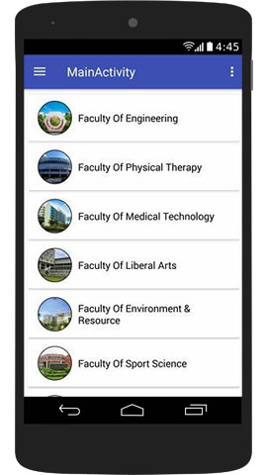
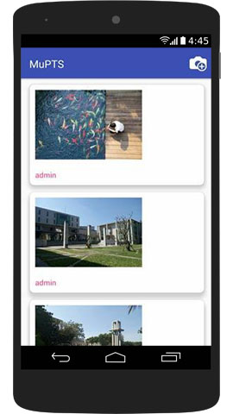
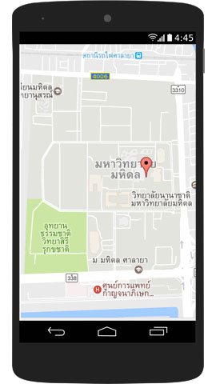
Demo application

Slide 8

Question & Answer

